Slide 1
Transductive Learning for Unsupervised Text Style Transfer
https://github.com/ xiaofei05/TSST
EMNLP-2021
Reported by Dongdong Hu

Slide 2
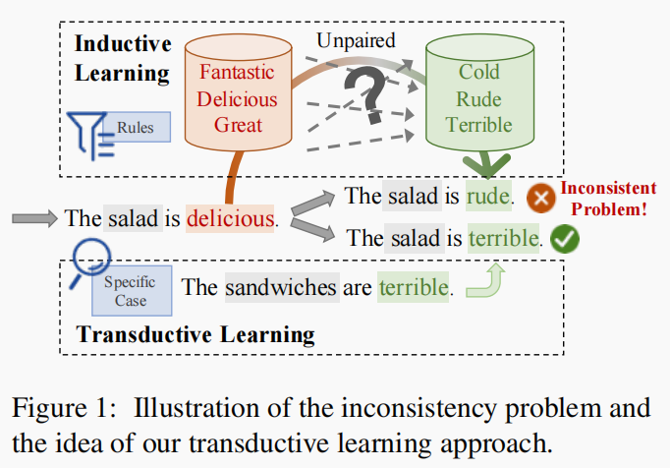
Introduction
Notes:
归纳学习是推导出规律学习规则
不会是一一对应的，是因为风格，高度依赖与上下文
但是对于无监督学习而言没有 平行的语料库进行训练
归纳学习 需要标签 归纳出规律
However, the lacking of parallel corpus
hinders the ability of these inductive learning methods on this task.

Slide 3
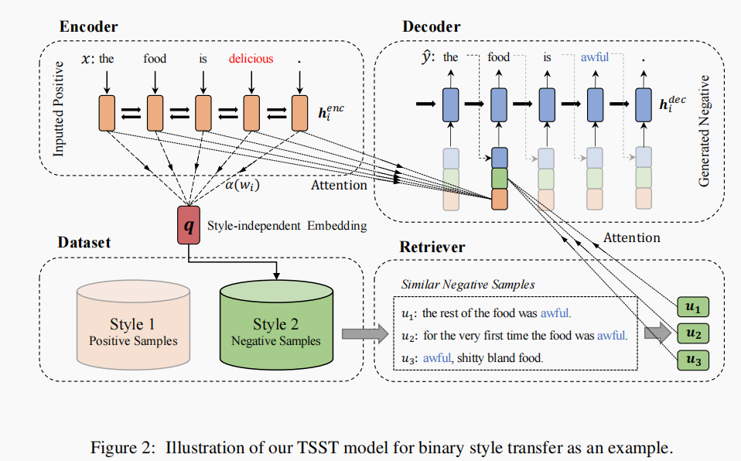
Method

Slide 4
Method

Slide 5
Method
Sparse Retriever (BM25)
Dense Retriever (MIPS)

Slide 6
Method

Slide 7
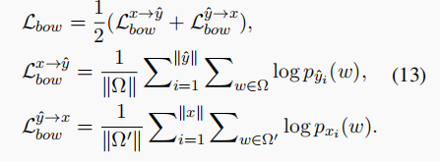
Method
Reconstruction Loss
Retrieval Loss
Bag-of-Words Loss
Cycle Reconstruction Loss
Adversarial Style Loss
Notes:
Retrieval Loss
The retrieval loss is designed to capture the similarity between the style
independent embeddings of the input sentence and the corresponding transferred sentence:
Bag-of-Words Loss
This loss is proposed to encourage the generator to select some new words
from the retrieved sentences, making our model pay more attention to the retrieved samples.

Slide 8
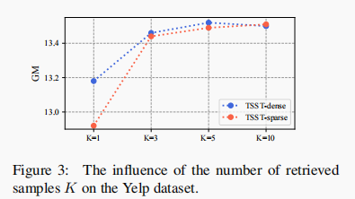
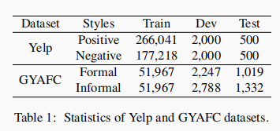
Experiments

Slide 9
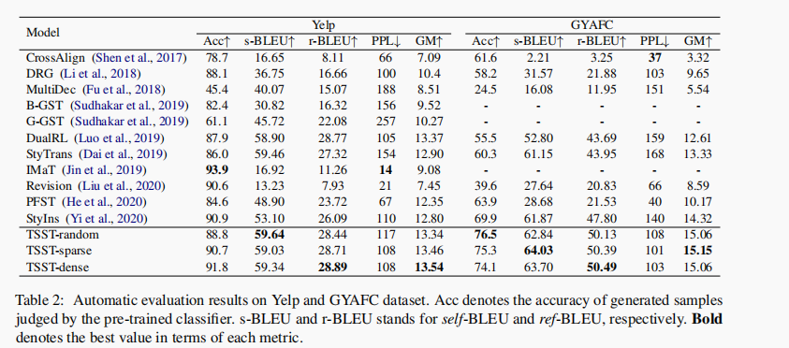
Experiments

Slide 10
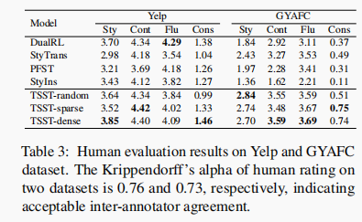
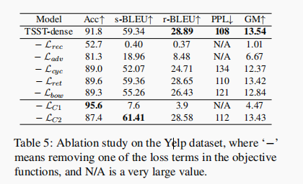
Experiments

Slide 11
Experiments

Slide 12
Thanks

